Slide 1
Parkinson-Brain-Biopsy-Project
PBBP42

Slide 2
Abholung von Probe Park_MD aus Magdeburg (6.2.)
Drei Sonden wurden mit ~4ml Trizol auf Trockeneis abgespült
RNA-Isolation mit Zymo DirectZol Micro Kit
Aufnahme in 100µl → nicht messbare Konzentration
Libraryprep im Blindflug: 16 Zyklen PCR; finale lib 7.8ng/µl

Slide 3
Analysis
Mapping with STAR against hg38
#dedupping with PICARD: ~82% Duplicates
STRingtie to assign Reads to a transcript model (GRCh38.p12)

Slide 4
2nd batch
Uwe Radelof holt am 5. -6.3. Samples aus MD:
1. sample: 4 Sonden, jeweils aus anderer Hirnregion (1-4), in jeweils 0.5ml Trizol
2. sample: 4 Sonden ?
→ 8 samples altogether

Slide 5
Samples L18300-L18307
Massive overamplification during library prep (13+15 cycles -> 28 cycles)→ final concentration ~30-70ng/µl (1-2ng/µl would be sufficient)
Massive duplication : 98%
→ next time use at least 10cycles less
Top transcripts are from chrM
Top nonChrM transcripts are MBP (Myelin), GFAP (Glia), HBB and HBA

Slide 6
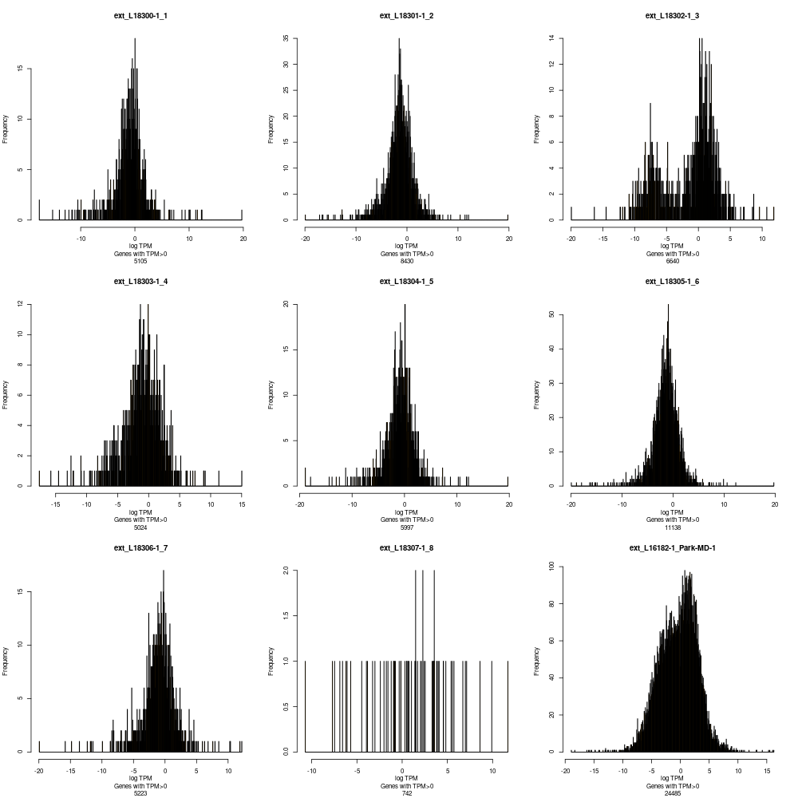
Histograms of gene expression (TPM)
Weird- maybe two cell populations?
Sample from feb2019
Only 16cycles PCR→higher complexity, ~25.000Genes in sample
Only 742 genes with reads

Slide 7
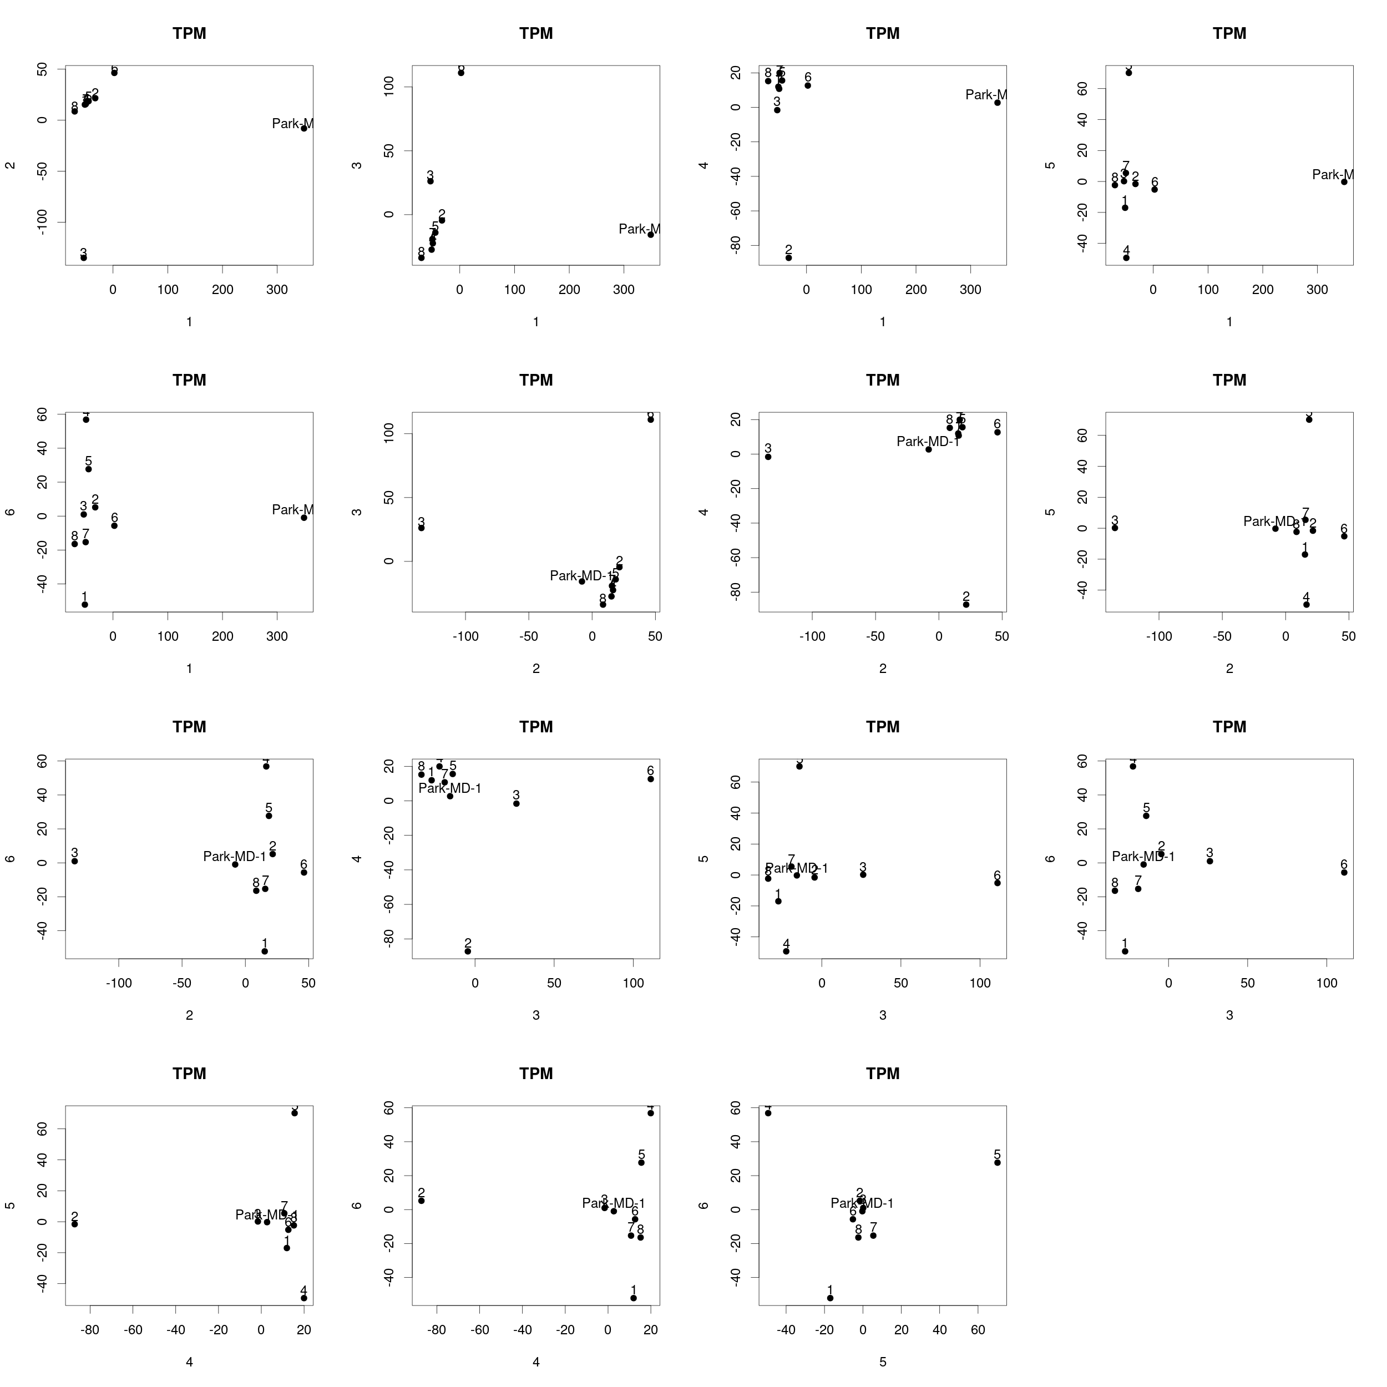
PCA

Slide 8
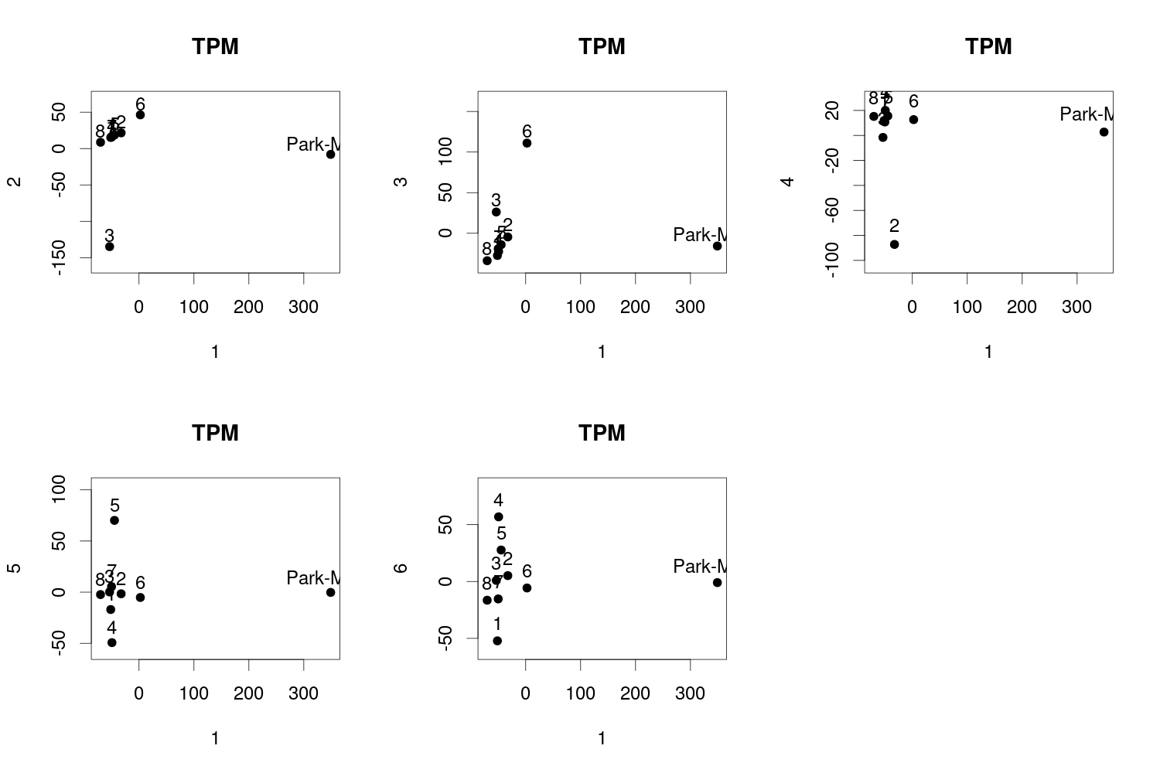
PCA zoomed (PC1 vs others)
PC1=MD vs novel samples
PC2=sample3 (weird distribution/heterogenous sample?)
PC3=sample 6
PC4=sample2
Interestingly, sample 8 with nearly no expressed genes is amidst the others

Slide 9
Highest expressed 20 genes
1 | 2 | 3 | 4 | 5 | 6 | 7 | 8 | Park-MD-1
MT-ND4L | MT-ND4L | MTATP6P1 | MT-ND4L | MT-ND4L | MT-ND4L | MT-ND4L | MT-ND4L | MT-ND4L
MT-ATP8 | MTATP6P1 | MT-ND4L | MT-ATP8 | MTATP6P1 | MTATP6P1 | MTATP6P1 | MT-ATP8 | MTATP6P1
MT-TC | MT-ATP8 | MT-ATP8 | MTATP8P1 | MT-ATP8 | MT-ATP8 | MT-ATP8 | HBA1 | MT-TC
MT-CO1 | MT-TC | MT-TC | MT-TC | MT-TC | MT-TC | MT-TC | MT-TC | MT-ATP8
MT-ND2 | MT-CO1 | HBA1 | MT-CO1 | MT-ND2 | MBP | HBA1 | HBA2 | HBA1
MTCO1P12 | MT-ND2 | MT-CO1 | MTCO1P12 | MT-CO1 | MT-CO1 | HBA2 | MT-CO1 | HBA2
HBA1 | MBP | MT-ND2 | MT-ND2 | MBP | MT-ND2 | MBP | MTCO1P12 | MT-CO1
MTND2P28 | MT-ND1 | MTCO1P12 | MTND2P28 | MTCO1P12 | MT-ND1 | MT-ND2 | MT-ND2 | MT-ND2
MT-ND1 | MTCO1P12 | MBP | MBP | MT-ND1 | MT-RNR2 | MT-CO1 | MTND2P28 | MBP
HBA2 | MT-RNR2 | HBA2 | MT-ND1 | MT-RNR2 | HBA1 | MT-ND1 | MT-TN | MT-ND1
MBP | MT-CO2 | MTND2P28 | MT-RNR2 | MT-CO3 | MT-CO2 | MTCO1P12 | MT-ND1 | HBB
MT-RNR2 | MT-CO3 | MT-ND1 | MT-CO3 | MT-CO2 | MT-CO3 | MT-RNR2 | MT-CO3 | MT-CO3
MT-CO3 | MTND2P28 | MT-CO3 | MT-CO2 | MTND2P28 | MTCO1P12 | MT-CO2 | MT-TS1 | MT-RNR2
MT-TS1 | MT-CYB | MTND1P23 | MT-RNR1 | HBA1 | MT-CYB | MT-CO3 | FP671120.3 | MT-CO2
MT-RNR1 | MT-TS1 | MT-RNR2 | MT-CYB | MT-TS1 | HBA2 | MTND2P28 | FP236383.2 | MTCO1P12
MT-CO2 | MT-RNR1 | MT-TS1 | MT-TM | MT-RNR1 | MT-ND6 | MT-TS1 | MBP | MT-CYB
MTND1P23 | MT-ND6 | MT-CO2 | MTND1P23 | MT-CYB | MT-RNR1 | MT-CYB | FP236383.3 | MT-ND6
MT-CYB | MT-ND5 | MT-RNR1 | MT-TS1 | MT-ND6 | MT-ND5 | MT-RNR1 | MTND1P23 | MT-ND5
FP236383.2 | MT-ND3 | BCYRN1 | MT-ND6 | MT-ND5 | MT-TS1 | MT-ND6 | MT-CO2 | MT-RNR1
FP671120.3 | MT-TL1 | FP236383.2 | MT-TA | MT-TN | MTND2P28 | MT-ND5 | MT-RNR2 | MT-TS1
Mostly mitochondria

Slide 10
Highest expressed 20 genes outside MT
1 | 2 | 3 | 4 | 5 | 6 | 7 | 8 | Park-MD-1
MTCO1P12 | MTATP6P1 | MTATP6P1 | MTATP8P1 | MTATP6P1 | MTATP6P1 | MTATP6P1 | HBA1 | MTATP6P1
HBA1 | MBP | HBA1 | MTCO1P12 | MBP | MBP | HBA1 | HBA2 | HBA1
MTND2P28 | MTCO1P12 | MTCO1P12 | MTND2P28 | MTCO1P12 | HBA1 | HBA2 | MTCO1P12 | HBA2
HBA2 | MTND2P28 | MBP | MBP | MTND2P28 | MTCO1P12 | MBP | MTND2P28 | MBP
MBP | HBA1 | HBA2 | MTND1P23 | HBA1 | HBA2 | MTCO1P12 | FP671120.3 | HBB
MTND1P23 | MTND1P23 | MTND2P28 | HBA1 | HBA2 | MTND2P28 | MTND2P28 | FP236383.2 | MTCO1P12
FP236383.2 | HBA2 | MTND1P23 | MTCO2P12 | MTND1P23 | MTND1P23 | HBB | MBP | MTND2P28
FP671120.3 | EEF1A1 | BCYRN1 | EEF1A1 | FP671120.3 | GFAP | MTND1P23 | FP236383.3 | BCYRN1
FP236383.3 | GFAP | FP236383.2 | MTCO3P12 | FP236383.2 | HBB | FP236383.2 | MTND1P23 | FP671120.3
MTCO3P12 | BCYRN1 | FP671120.3 | EEF1A1P5 | FP236383.3 | FTH1 | FP671120.3 | FP671120.4 | FP236383.2
MTCO2P12 | MTCO2P12 | HSPA1A | MOBP | CCL2 | MOBP | FP236383.3 | EEF1A1 | FP236383.3
EEF1A1 | FP236383.2 | FP236383.3 | HBA2 | BCYRN1 | PLP1 | BCYRN1 | RPL7 | FTH1
BCYRN1 | FP671120.3 | RPL41P1 | AC126755.2 | MOBP | EEF1A1 | MTCO2P12 | RPL21P16 | MTND1P23
FP671120.4 | FP236383.3 | EEF1A1 | BCYRN1 | EEF1A1 | FP236383.2 | MOBP | HBB | EEF1A1
RPL41P1 | FTH1 | RPL23AP42 | HSPA1A | MTCO2P12 | FP671120.3 | EEF1A1 | Z83840.1 | FTL
GFAP | MOBP | MTCO2P12 | FP671120.3 | EEF1A1P5 | BCYRN1 | FTH1 | RPL23AP42 | GFAP
EEF1A1P5 | EEF1A1P5 | EEF1A1P5 | FP236383.2 | FTH1 | FP236383.3 | FP671120.4 | MTCO2P12 | PLP1
RPL23AP42 | RPL41P1 | UBC | RPL41P1 | RPL23AP42 | FTL | GFAP | HSPA1A | TMSB4X
HSPA1A | PLP1 | HSPA1B | RPL6P27 | RPL41P1 | BCAS1 | RPL41P1 | FTH1P7 | S100A9
UBC | FTL | AC090498.1 | FP236383.3 | PLP1 | MTCO2P12 | BCAS1 | MTCO3P12 | MTCO2P12
MBP=Myelin basic protein
HBA=Hemoglobin
BCYRN1=Brain cytoplasmic RNA1 (primate tissue-specific RNA polymerase III transcript)
GFAP=Glial Fibrillary Acidic Protein
FTH1=ferritin heavy chain (Defects in ferritin proteins are associated with several neurodegenerative diseases)

Slide 11
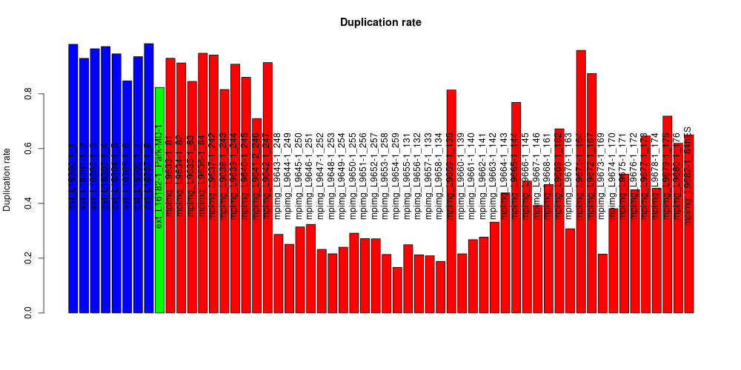
Compare data to brain organoids (Yechiel Elkabetz, confidential)

Slide 12
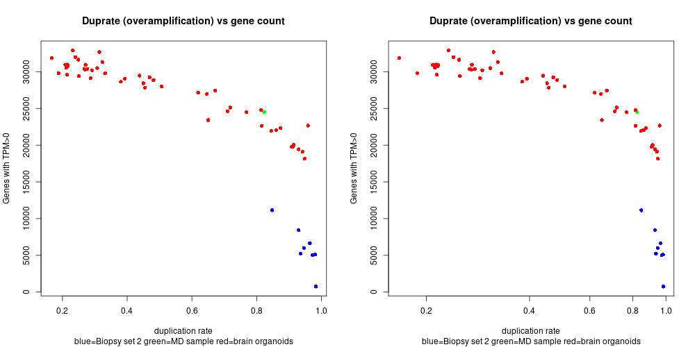
Gene counts vs duprates
X= Log scale
As expected , a lower duprate might lead to higher gene counts
The MD sample from spring 2019 has a comparably high gene count

Slide 13
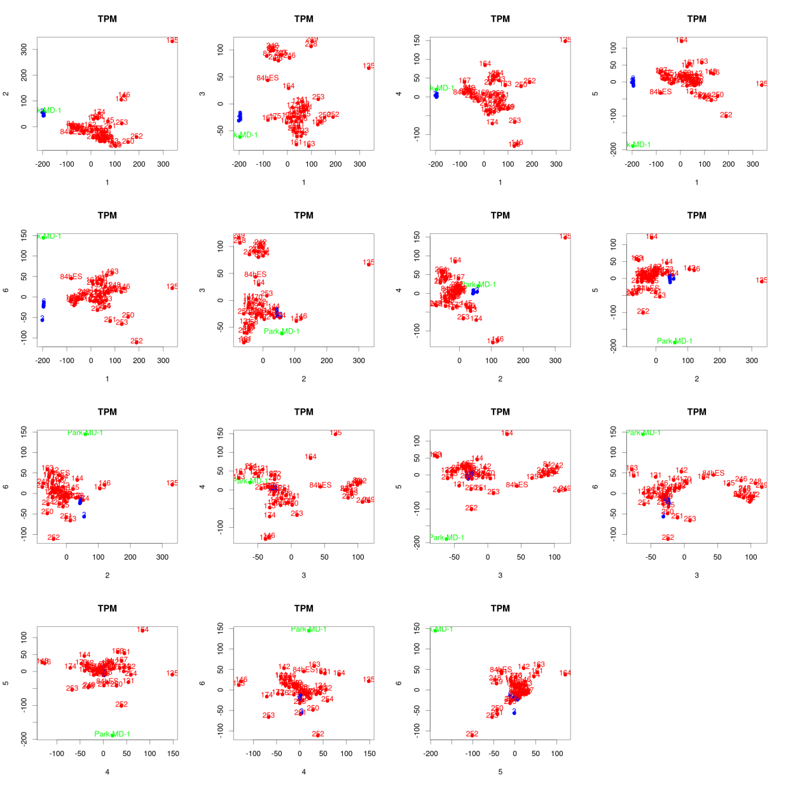
PCA
Organoid 135
Sample 135 is an outlier (also has a high duprate)
Repeat PCA w/o sample 135

Slide 14
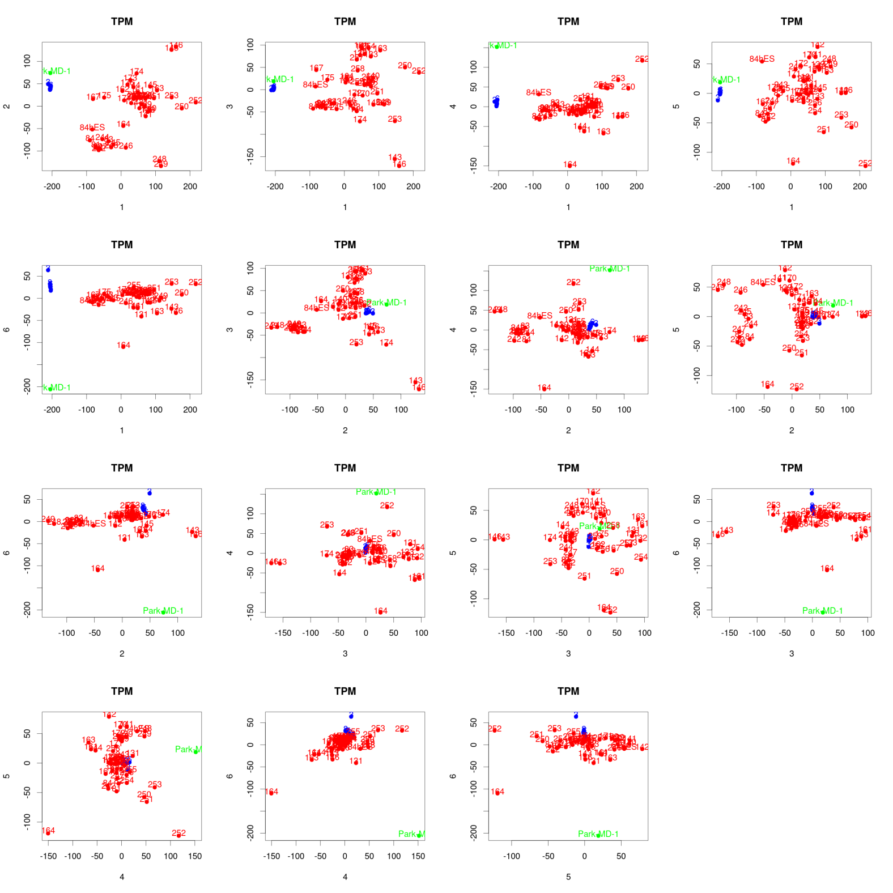
PCA w/o brain organoid 135

Slide 15
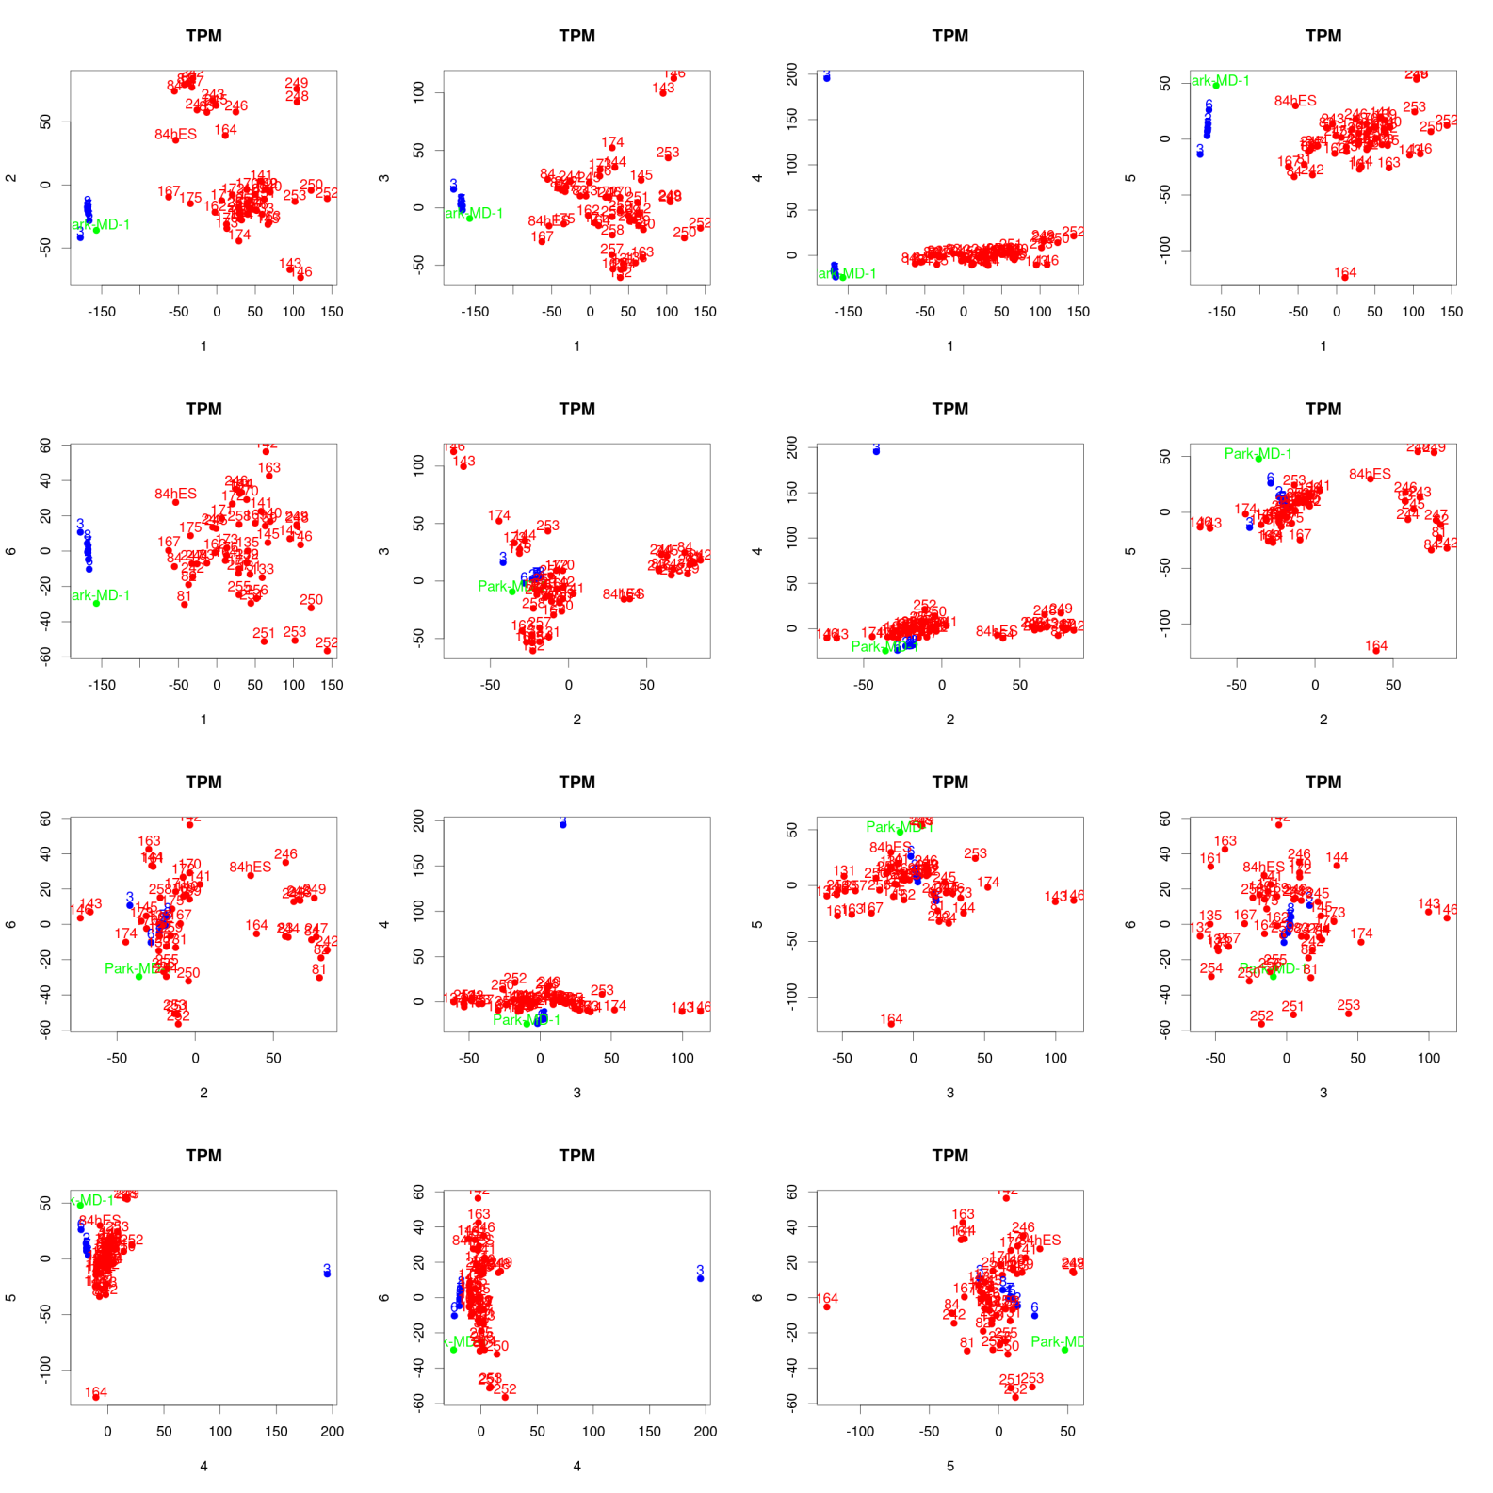
PCA wo brain organoid 135 (only genes expressed in biopsy samples)

Slide 16
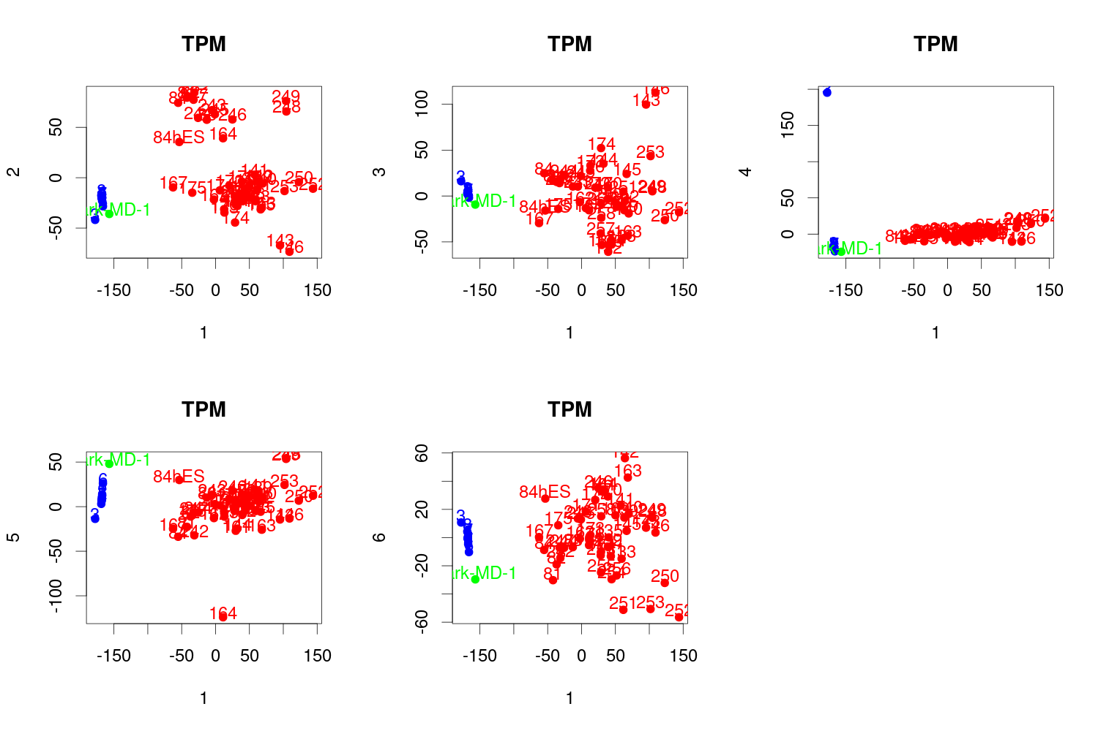
zoom
Biopsie samples (except Biopsie3) are more homogenous than brain organoids→ only a few cells, at least 4 biopsies from same patient

Slide 17
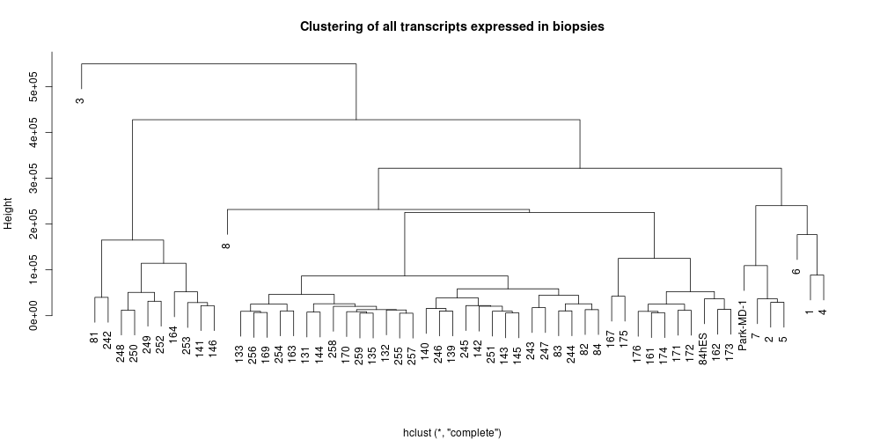
Sample 3 is clearly an outlier
If 1-4 and 5-8 are from the same patient, this is not reflected by the clusters

Slide 18
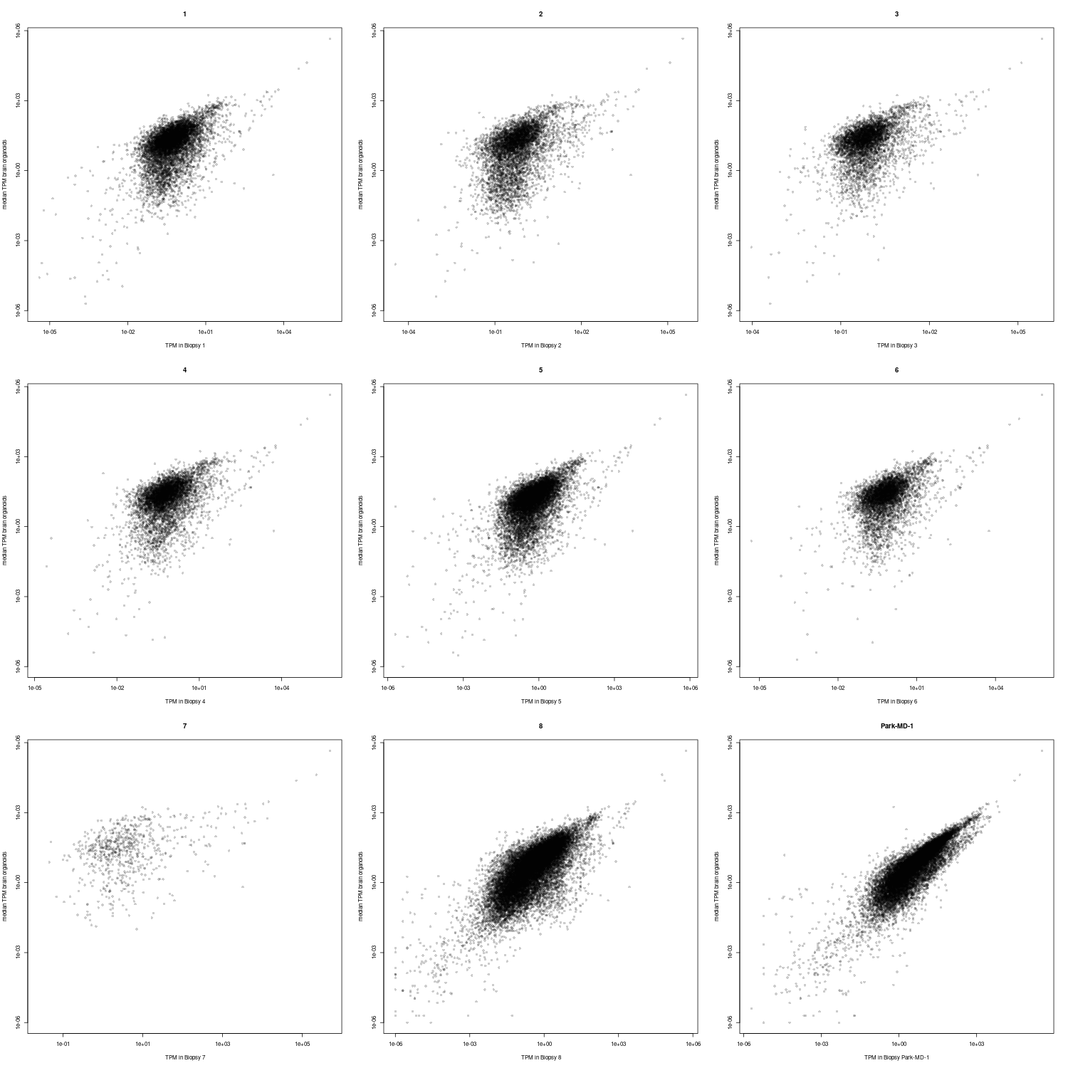
Do we find the highest expressed brain organoid genes in the biopsy samples?
YES!

Slide 19
Do we find the highest X expressed brain genes expressed in biopsies
Fraction of genes found in biopsies (TPM>0)
bestXgenes | 1 | 2 | 3 | 4 | 5 | 6 | 7 | 8 | Park-MD-1
10 | 0.9 | 0.9 | 0.9 | 0.9 | 0.9 | 0.9 | 0.9 | 0.9 | 0.9
50 | 0.98 | 0.98 | 0.96 | 0.98 | 0.98 | 0.98 | 0.98 | 0.7 | 0.98
100 | 0.98 | 0.98 | 0.95 | 0.97 | 0.99 | 0.99 | 0.98 | 0.65 | 0.99
500 | 0.83 | 0.936 | 0.778 | 0.83 | 0.88 | 0.962 | 0.854 | 0.306 | 0.996
1000 | 0.772 | 0.903 | 0.673 | 0.748 | 0.812 | 0.948 | 0.769 | 0.204 | 0.995
1500 | 0.716 | 0.875 | 0.624 | 0.69067 | 0.766 | 0.941 | 0.71867 | 0.1667 | 0.99467
2000 | 0.6685 | 0.851 | 0.5765 | 0.649 | 0.732 | 0.9295 | 0.6725 | 0.1395 | 0.9935
1 of the most expressed genes in brain organoids not found at all
TTR : Transthyretin; Mutations in this gene are associated with amyloid deposition, predominantly affecting peripheral nerves or the heart, while a small percentage of the gene mutations are non-amyloidogenic

Slide 20
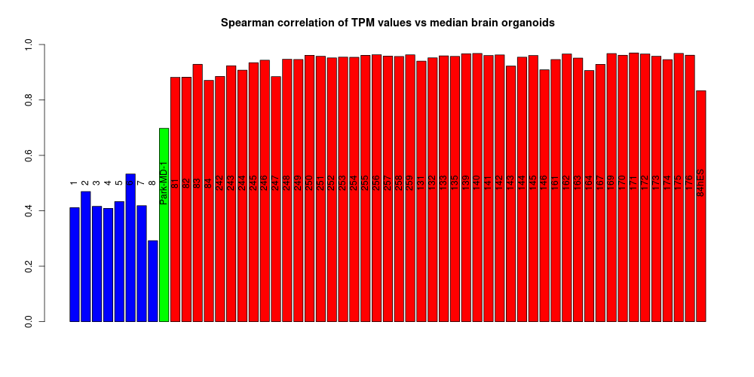
Spearman correlations
Sample MD1 from Spring looks quite good. Unfortunately, we do not have an outgroup at hand
→ take some other human RNA data.../download?

Slide 21
Median(Rank of gene in biopsy sample/rank of gene in median brain sample)
MD sample
bestXgenes | 1 | 2 | 3 | 4 | 5 | 6 | 7 | 8 | Park-MD-1 | 81 | 82 | 83 | 84 | 242 | 243 | 244 | 245 | 246 | 247 | 248 | 249 | 250 | 251 | 252 | 253 | 254 | 255 | 256 | 257 | 258 | 259 | 131 | 132 | 133 | 135 | 139 | 140 | 141 | 142 | 143 | 144 | 145 | 146 | 161 | 162 | 163 | 164 | 167 | 169 | 170 | 171 | 172 | 173 | 174 | 175 | 176 | 84hES
10 | 1.58 | 1.54 | 2.08 | 1.63 | 1.61 | 1.54 | 2.05 | 1.8 | 2 | 1.88 | 1.3 | 1 | 1.5 | 2.04 | 1 | 1.07 | 1.08 | 1 | 1.23 | 1 | 1.29 | 1 | 1 | 1 | 1 | 1 | 1 | 1 | 1 | 1 | 1 | 1 | 1 | 1 | 1 | 1 | 1 | 1.38 | 1 | 1 | 1 | 1 | 1.14 | 1 | 1.08 | 1 | 2.05 | 1.12 | 1 | 1 | 1 | 1 | 1 | 1 | 1.07 | 1 | 1
50 | 2.68 | 2.5 | 3.17 | 3.34 | 2.67 | 2.76 | 2.66 | 4.29 | 2.62 | 1.62 | 1.46 | 1.21 | 1.88 | 1.7 | 1.03 | 1.45 | 1.21 | 1 | 1.41 | 1 | 1.08 | 1.14 | 1.09 | 1.11 | 1.05 | 1.04 | 1.07 | 1 | 1.04 | 1.14 | 1.05 | 1.02 | 1.03 | 1.13 | 1.02 | 1.01 | 1 | 1.42 | 1.04 | 1.42 | 1.26 | 1.07 | 1.49 | 1.14 | 1.06 | 1.16 | 2.42 | 1.37 | 1 | 1 | 1 | 1.03 | 1.22 | 1.19 | 1.14 | 1.14 | 1
100 | 2.65 | 2.38 | 3.46 | 3.22 | 2.7 | 2.34 | 2.42 | 4.71 | 2.25 | 1.5 | 1.3 | 1.13 | 1.69 | 1.53 | 1.04 | 1.39 | 1.12 | 1 | 1.36 | 1 | 0.96 | 1.06 | 1.04 | 1.04 | 1.09 | 1.03 | 1.06 | 1 | 1.01 | 1.13 | 1.04 | 1.02 | 1 | 1.02 | 1 | 1.01 | 1 | 1.32 | 1.06 | 1.44 | 1.2 | 1.04 | 1.64 | 1.14 | 1.04 | 1.13 | 2.01 | 1.3 | 1 | 1 | 1 | 1.02 | 1.18 | 1.2 | 1.06 | 1.14 | 1
500 | 3.54 | 3.09 | 4.12 | 3.34 | 3.17 | 2.75 | 2.94 | 29.17 | 2.68 | 1.48 | 1.37 | 1.17 | 1.57 | 1.52 | 1.17 | 1.33 | 1.18 | 1.06 | 1.35 | 1.03 | 1.06 | 1.04 | 1.08 | 1.07 | 1.07 | 1.09 | 1.07 | 1.06 | 1.08 | 1.1 | 1.03 | 1.08 | 1.13 | 1.09 | 1.07 | 1.06 | 1.05 | 1.15 | 1.09 | 1.38 | 1.18 | 1.08 | 1.49 | 1.17 | 1.03 | 1.12 | 1.69 | 1.3 | 1.03 | 1.04 | 1.04 | 1.03 | 1.14 | 1.18 | 1.06 | 1.1 | 1.2
1000 | 3.06 | 2.83 | 4.31 | 3.21 | 2.94 | 2.53 | 2.98 | 19.64 | 2.53 | 1.45 | 1.37 | 1.18 | 1.54 | 1.48 | 1.19 | 1.32 | 1.21 | 1.11 | 1.35 | 1.05 | 1.08 | 1.04 | 1.06 | 1.08 | 1.09 | 1.09 | 1.08 | 1.05 | 1.08 | 1.08 | 1.03 | 1.09 | 1.11 | 1.09 | 1.08 | 1.06 | 1.05 | 1.12 | 1.12 | 1.34 | 1.19 | 1.09 | 1.44 | 1.16 | 1.03 | 1.11 | 1.58 | 1.27 | 1.04 | 1.06 | 1.04 | 1.05 | 1.13 | 1.15 | 1.06 | 1.1 | 1.27
1500 | 2.95 | 2.66 | 4.36 | 3.07 | 2.77 | 2.35 | 2.79 | 14.92 | 2.33 | 1.42 | 1.37 | 1.18 | 1.5 | 1.45 | 1.19 | 1.31 | 1.2 | 1.12 | 1.34 | 1.06 | 1.08 | 1.04 | 1.08 | 1.07 | 1.09 | 1.1 | 1.09 | 1.05 | 1.09 | 1.08 | 1.03 | 1.09 | 1.11 | 1.09 | 1.09 | 1.06 | 1.05 | 1.1 | 1.11 | 1.3 | 1.16 | 1.09 | 1.36 | 1.14 | 1.03 | 1.11 | 1.5 | 1.24 | 1.05 | 1.05 | 1.04 | 1.03 | 1.11 | 1.14 | 1.06 | 1.08 | 1.3
2000 | 2.88 | 2.48 | 4.69 | 2.93 | 2.57 | 2.21 | 2.75 | 11.77 | 2.2 | 1.39 | 1.34 | 1.16 | 1.45 | 1.41 | 1.18 | 1.29 | 1.19 | 1.12 | 1.32 | 1.06 | 1.08 | 1.04 | 1.08 | 1.07 | 1.09 | 1.09 | 1.07 | 1.05 | 1.09 | 1.07 | 1.04 | 1.1 | 1.11 | 1.09 | 1.08 | 1.05 | 1.05 | 1.09 | 1.11 | 1.28 | 1.15 | 1.08 | 1.32 | 1.13 | 1.03 | 1.11 | 1.46 | 1.23 | 1.04 | 1.05 | 1.04 | 1.04 | 1.1 | 1.13 | 1.05 | 1.07 | 1.3
Biopsies 1-8
Brain organoids
How similar are the samples to the median brain organoid
1=nearly perfect match
Expressed genes only
bestXgenes | 1 | 2 | 3 | 4 | 5 | 6 | 7 | 8 | Park-MD-1 | 81 | 82 | 83 | 84 | 242 | 243 | 244 | 245 | 246 | 247 | 248 | 249 | 250 | 251 | 252 | 253 | 254 | 255 | 256 | 257 | 258 | 259 | 131 | 132 | 133 | 135 | 139 | 140 | 141 | 142 | 143 | 144 | 145 | 146 | 161 | 162 | 163 | 164 | 167 | 169 | 170 | 171 | 172 | 173 | 174 | 175 | 176 | 84hES
10 | 1.4 | 1.45 | 2.08 | 1.45 | 1.6 | 1.5 | 1.78 | 1.8 | 1.88 | 1.88 | 1.3 | 1 | 1.5 | 2.04 | 1 | 1.07 | 1.08 | 1 | 1.23 | 1 | 1.29 | 1 | 1 | 1 | 1 | 1 | 1 | 1 | 1 | 1 | 1 | 1 | 1 | 1 | 1 | 1 | 1 | 1.38 | 1 | 1 | 1 | 1 | 1.14 | 1 | 1.08 | 1 | 2.05 | 1.12 | 1 | 1 | 1 | 1 | 1 | 1 | 1.07 | 1 | 1
50 | 2.76 | 2.39 | 3.23 | 3.35 | 2.66 | 2.82 | 2.66 | 3.09 | 2.59 | 1.62 | 1.43 | 1.21 | 1.91 | 1.7 | 1.05 | 1.49 | 1.24 | 1 | 1.41 | 1 | 1.08 | 1.14 | 1.09 | 1.11 | 1.05 | 1.04 | 1.07 | 1 | 1.04 | 1.14 | 1.05 | 1.02 | 1.03 | 1.13 | 1.02 | 1.01 | 1 | 1.42 | 1.04 | 1.42 | 1.26 | 1.07 | 1.49 | 1.14 | 1.06 | 1.16 | 2.42 | 1.37 | 1 | 1 | 1 | 1.03 | 1.22 | 1.19 | 1.14 | 1.14 | 1
100 | 2.71 | 2.38 | 3.43 | 3.25 | 2.69 | 2.32 | 2.42 | 2.99 | 2.16 | 1.5 | 1.29 | 1.13 | 1.7 | 1.53 | 1.05 | 1.41 | 1.12 | 1 | 1.36 | 1 | 0.96 | 1.06 | 1.04 | 1.04 | 1.09 | 1.03 | 1.06 | 1 | 1.01 | 1.13 | 1.04 | 1.02 | 1 | 1.02 | 1 | 1.01 | 1 | 1.32 | 1.06 | 1.44 | 1.2 | 1.04 | 1.64 | 1.14 | 1.04 | 1.13 | 2.01 | 1.3 | 1 | 1 | 1 | 1.02 | 1.18 | 1.2 | 1.06 | 1.14 | 1
500 | 2.92 | 2.83 | 3.26 | 2.82 | 2.78 | 2.68 | 2.72 | 1.49 | 2.71 | 1.48 | 1.38 | 1.17 | 1.58 | 1.52 | 1.17 | 1.35 | 1.19 | 1.06 | 1.34 | 1.03 | 1.06 | 1.04 | 1.08 | 1.07 | 1.07 | 1.09 | 1.08 | 1.06 | 1.08 | 1.1 | 1.03 | 1.08 | 1.13 | 1.09 | 1.07 | 1.06 | 1.05 | 1.15 | 1.09 | 1.38 | 1.18 | 1.08 | 1.49 | 1.17 | 1.03 | 1.12 | 1.69 | 1.3 | 1.03 | 1.04 | 1.04 | 1.03 | 1.14 | 1.18 | 1.06 | 1.1 | 1.2
1000 | 2.54 | 2.62 | 2.69 | 2.51 | 2.47 | 2.4 | 2.38 | NA | 2.51 | 1.45 | 1.38 | 1.18 | 1.55 | 1.48 | 1.2 | 1.33 | 1.22 | 1.11 | 1.35 | 1.05 | 1.08 | 1.04 | 1.06 | 1.08 | 1.09 | 1.09 | 1.08 | 1.05 | 1.08 | 1.08 | 1.03 | 1.09 | 1.11 | 1.09 | 1.08 | 1.06 | 1.05 | 1.12 | 1.12 | 1.34 | 1.19 | 1.09 | 1.44 | 1.16 | 1.03 | 1.11 | 1.58 | 1.27 | 1.04 | 1.06 | 1.04 | 1.05 | 1.13 | 1.15 | 1.06 | 1.1 | 1.27
1500 | 2.17 | 2.35 | 2.34 | 2.16 | 2.15 | 2.27 | 2.1 | NA | 2.32 | 1.43 | 1.37 | 1.18 | 1.51 | 1.45 | 1.19 | 1.32 | 1.2 | 1.12 | 1.34 | 1.06 | 1.08 | 1.04 | 1.08 | 1.07 | 1.09 | 1.1 | 1.09 | 1.05 | 1.09 | 1.08 | 1.03 | 1.09 | 1.12 | 1.09 | 1.09 | 1.06 | 1.05 | 1.1 | 1.11 | 1.3 | 1.16 | 1.09 | 1.36 | 1.14 | 1.03 | 1.11 | 1.5 | 1.24 | 1.05 | 1.05 | 1.05 | 1.03 | 1.11 | 1.14 | 1.06 | 1.08 | 1.3
2000 | 1.85 | 2.12 | 2.14 | 1.87 | 1.96 | 2.13 | 1.85 | NA | 2.2 | 1.39 | 1.35 | 1.16 | 1.46 | 1.41 | 1.19 | 1.29 | 1.19 | 1.12 | 1.32 | 1.06 | 1.08 | 1.04 | 1.08 | 1.07 | 1.09 | 1.09 | 1.08 | 1.05 | 1.09 | 1.07 | 1.04 | 1.1 | 1.11 | 1.09 | 1.08 | 1.05 | 1.05 | 1.09 | 1.11 | 1.28 | 1.15 | 1.08 | 1.32 | 1.13 | 1.03 | 1.11 | 1.46 | 1.23 | 1.04 | 1.05 | 1.04 | 1.04 | 1.1 | 1.13 | 1.05 | 1.07 | 1.3

Slide 22
Conclusions
Strictly reduce number of PCR cycles:
Neg. correlation of library complexity and PCR cycle number (duplication rate)→ use UMIs so dedupping won‘t skew the gene expression values
It is possible to get sequencing libs from biopsies
Needs a lot of optimization (single cell protocol?; use ERCC spike ins?; pool samples before PCR step and reduce cycle number?)
Highest expressed genes are also found highly expressed in brain organoids

Slide 23
Further thoughts
The data might be sufficient for differential expression analyses given a large number of samples (low dup rates) and a large number of controls (from non affected brains)
Better to include more samples than to increase sequencing depth.
If it is possible to apply the Smarter protocol (single cell RNA library prep (Takara)) for cDNA generation → full length transcripts could be sequenced on PacBio potentially revealing unusual splice isoforms/fusion transcripts

